Slide 1

SDET Course
Design Patterns - Iterator

Slide 2
3 Types of Design Patterns
Creational
Singleton
Builder
Prototype
Factory Method
Abstract Factory
Structural
Adapter
Composite
Proxy
Flyweight
Bridge
Facade
Decorator
Behavioral
Strategy
Observer
Command
Memento
State
Template Method
Mediator
Chain of Responsibility
Interpreter
Visitor
Iterator

Slide 3
Agenda
Description
Diagram
Code sample (Java)
Use cases

Slide 4

Description
Introduction - Read Blog Posts

Slide 5
Description
The Iterator design pattern is a behavioral design pattern that provides a way to access elements of an aggregate object sequentially without exposing its underlying representation. It defines a common interface for iterating over various types of collections, such as lists, arrays, trees, or other complex data structures, without needing to know the specific details of each structure. This pattern decouples the iteration logic from the aggregate object, promoting code reusability and flexibility. By encapsulating iteration within a separate object, it allows for multiple iterators to traverse the same collection concurrently or in different ways, facilitating efficient and versatile traversal of data structures.

Slide 6
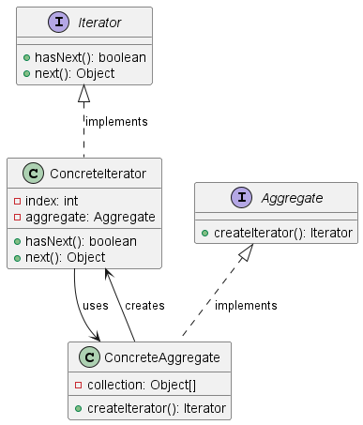
Class Diagram

Slide 7
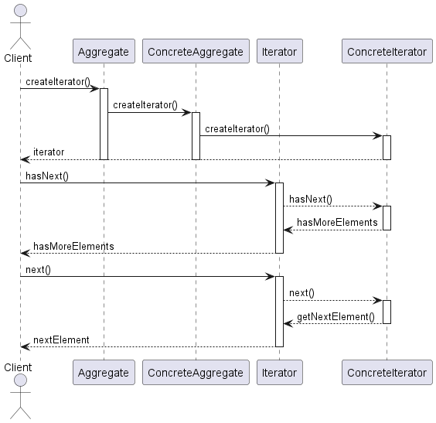
Sequence Diagram

Slide 8
Code Sample

Slide 9
Use cases
General
Menu Iteration in GUIs
Database Query Results
Tree Traversal Algorithms
Collections Frameworks
In Test Automation
Iterate through users
Iterate through table entries
Iterate through SQL results

Slide 10
Happy Coding

